Slide 1
The GLOBE Program in Asia-Pacific Region
By
Dr. Desh Bandhu,
Coordinator
GLOBE Asia-Pacific Regional Coordination office

Slide 2
Activities in the Asia – Pacific Region (June, 2018 to May, 2019)
GLOBE Teacher’s Training Program in Malé, Maldives During April 3-4, 2019
GLOBE Teacher's Training Program in Koror, Palau during January 24 – 25, 2019.
GLOBE International Exchange Program during 15-18 January, 2019 (Seoul – Taiwan)
Young Friends of Environment Program during January 5- 9, 2019
2018 GLOBE Japan Student Conference in Tokyo, Japan during 23-24 November, 2018
GLOBE Learning Expedition to Lake Pokhara in Nepal during October 2-8, 2018.
2018 GLOBE Science Festival in Taichung, Taiwan July 20-22, 2018
GLOBE Teacher's Training, Hanoi, Vietnam during May 5, 2018
Implementation of GLOBE ZIKA Education & Prevention program

Slide 3
GLOBE Teacher’s Training Program Malé, Maldives
GLOBE Teachers training were organized in Malé, Maldives during April 1-5, 2019.
The training was attended by 25 teachers from different School in Malé, Maldives. Participants
The Minister of Environment, State Minister of Environment and Permanent Secretary of the Ministry joined with the participants.
The video message of Dr. Tony P. Murphy, Director, GIO was also screened during the training program and was appreciated by the participants.
The “Expedition To The Sea” was also organized as planned during last year RM.
The participants and trainers from Philippines, India, Thailand and Oman joined the event.
Two hours Ocean Bundle Protocol was organized during the event.

Slide 4
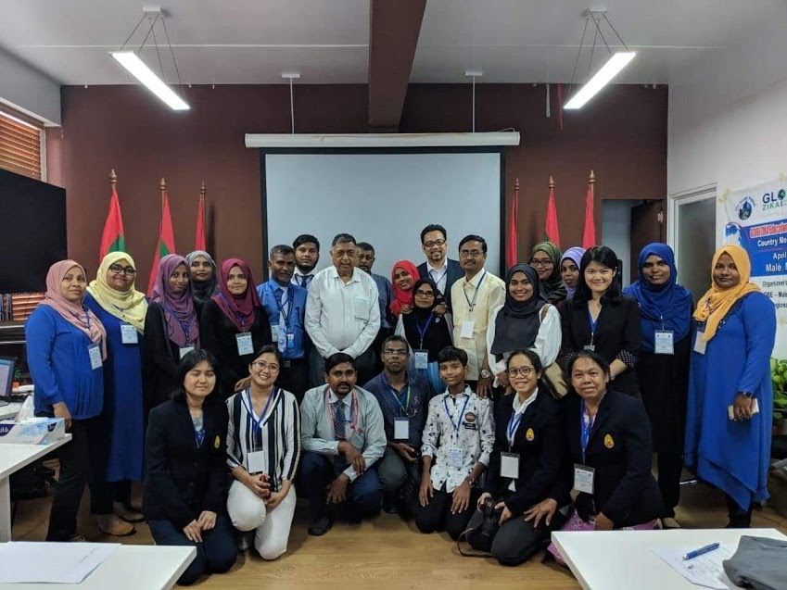
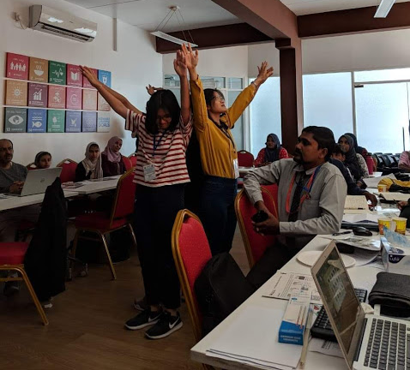
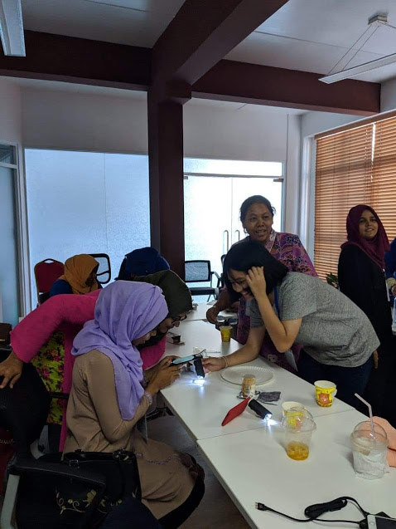

Slide 5
GLOBE Teacher's Training Program Koror, Palau
GLOBE Teacher Training Workshop was conducted on January 24 -25, 2019 in koror.
The training was attended by 25 teachers from different School in koror, Palau.
GLOBE Protocol such as atmosphere, Land cover & soil.
Dr. R.K.Garg & Dr. Desh Bandhu were the master trainer for the program.
A training was of two days & a hands-on approach was followed during the training so that participants can do all the experiments during the workshop, GLOBE MHM App was also discussed during the training program.

Slide 6
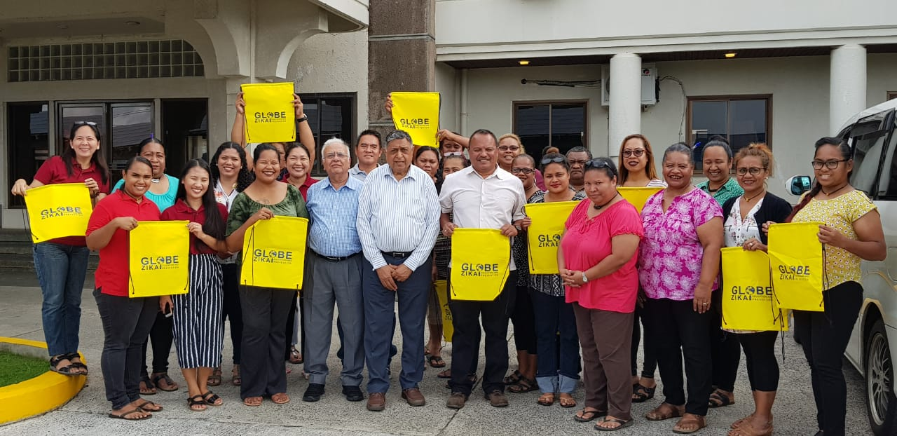
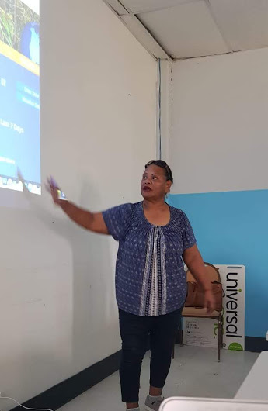
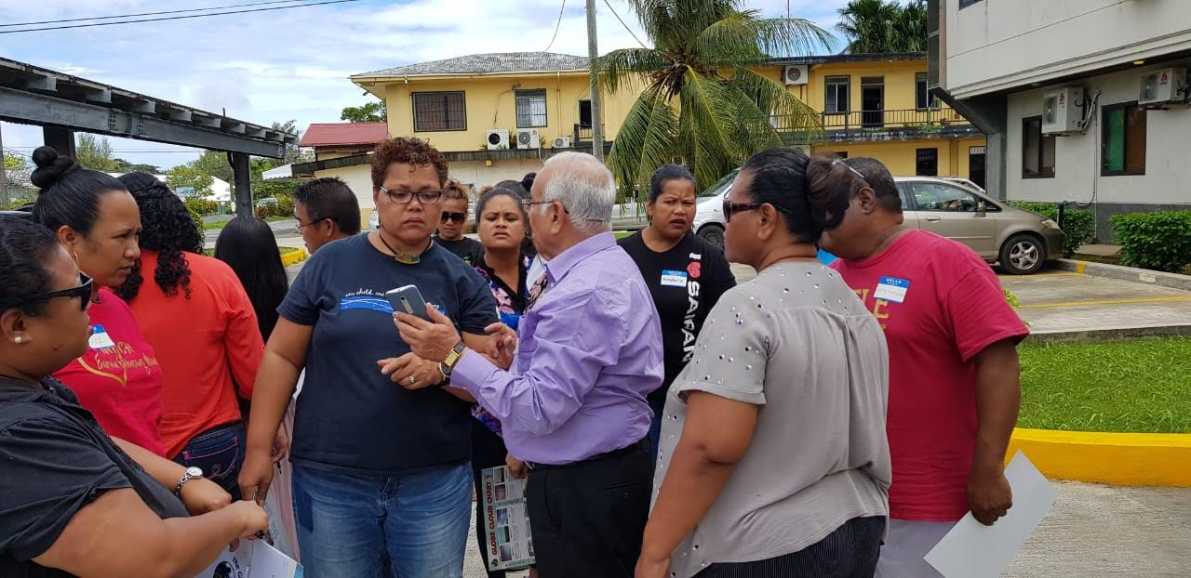

Slide 7
GLOBE International Exchange Program
Students from GLOBE School - Taiwan visited GLOBE School in South Korea during 15 – 18 Jan 2019.
Nine students, accompanied by their teacher and the Taiwan Country Coordinator for GLOBE accompany them.
Students from both the Countries share the results of their GLOBE research and to gain a better understanding of how students at other schools have been similarly involved in GLOBE

Slide 8
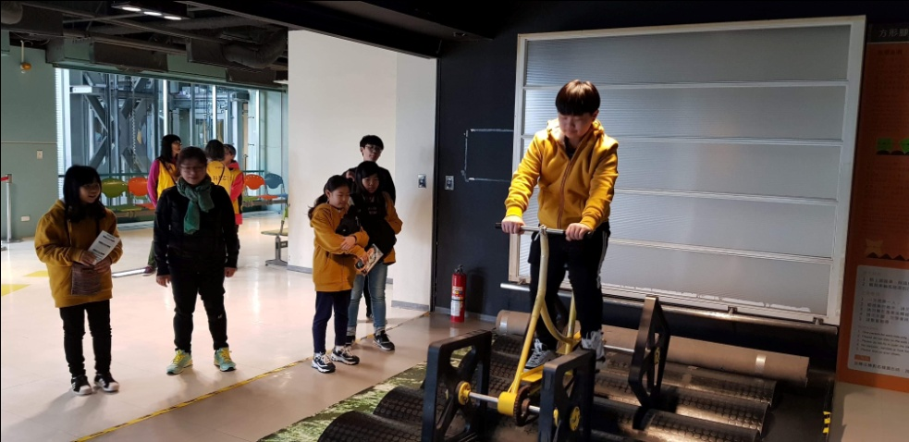
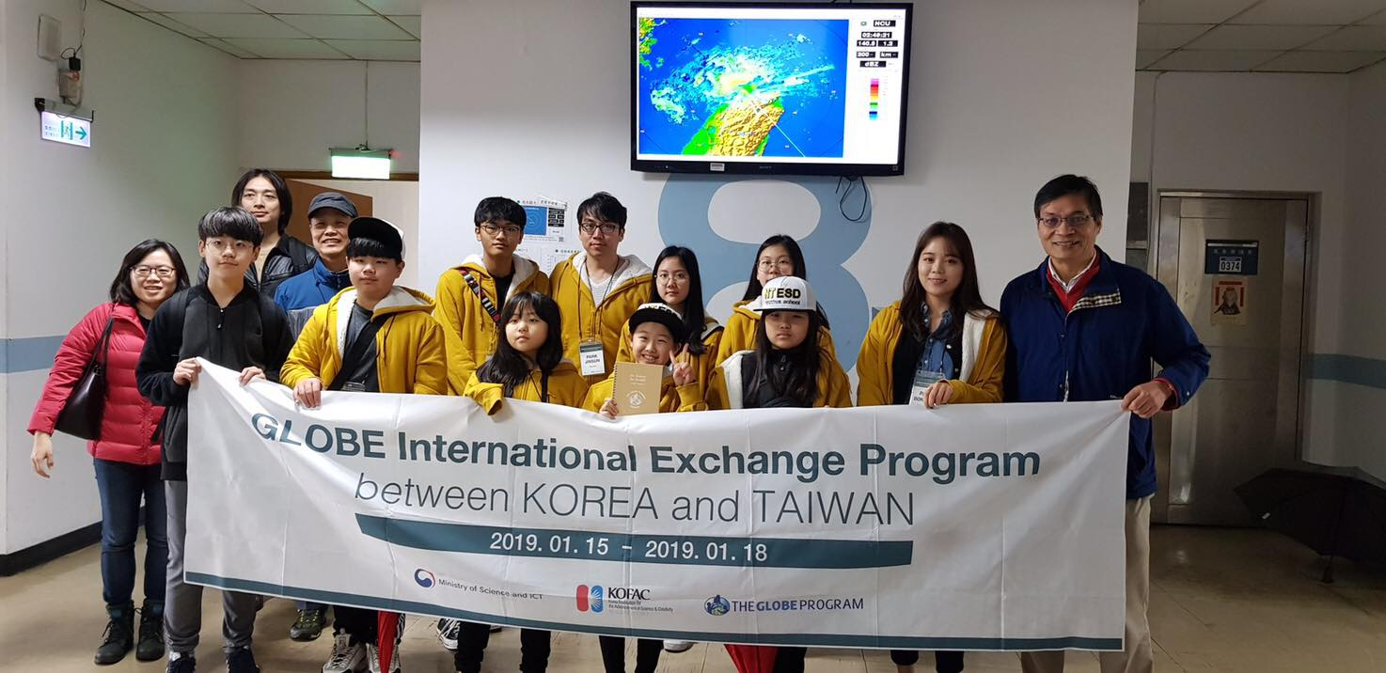
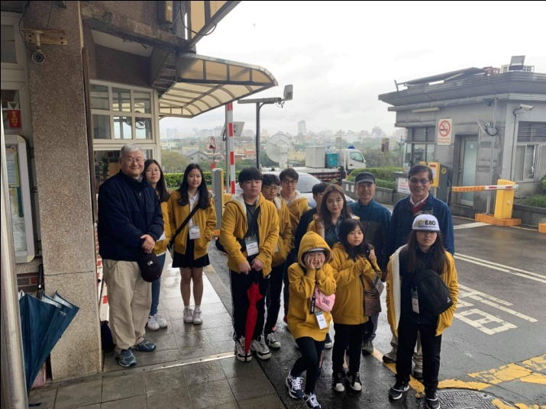

Slide 9
Young Friends of Environment – Expedition Panjim ,Goa
IES organized Young Friends of Environment – Expedition for during January 5 - 9, 2019 in Panjim, Goa.
22 Students from Telengana, Hyderabad & Delhi participated in the Expedition.
During the expeditions the participants had the opportunity to perform Hydrology protocols on River Mandvi and Beach (Marine water) and they compare the data to learn the difference in water parameters of fresh and marine water.
Students also engage in Soil & Atmosphere protocol during the expedition.
We are planning the make this a early expedition in the region & incurage participation from other countries in the region.

Slide 10
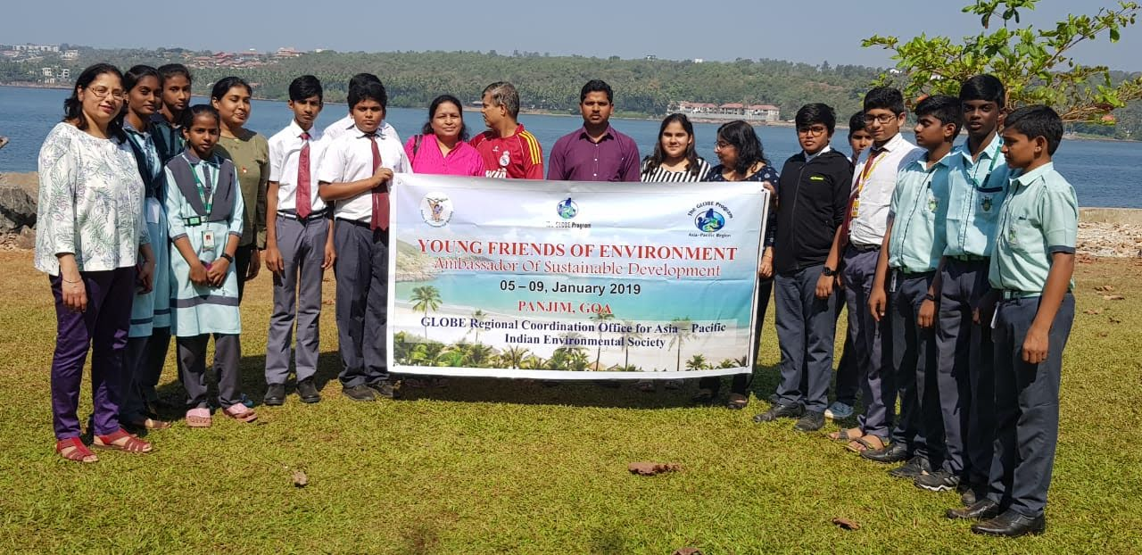
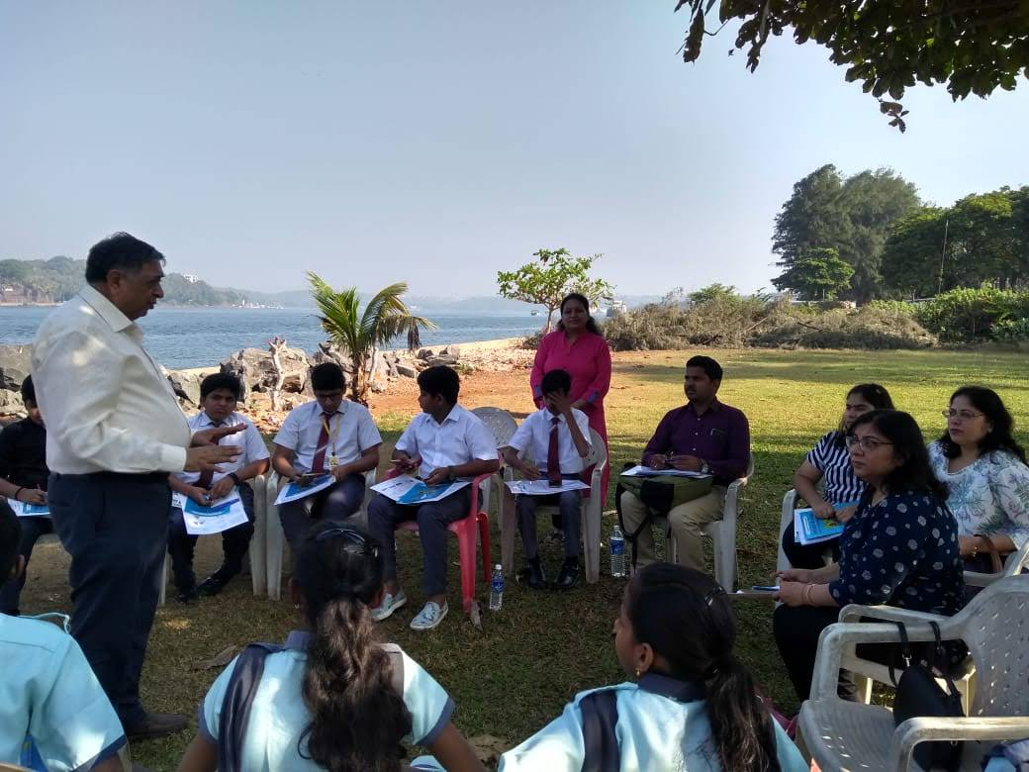

Slide 11
GLOBE Japan Student Conference
GLOBE Japan organized their 10th GLOBE Students Conference in Japan during 23-24 November, 2018 .
The event was held at Tokyo Gakugei University and Koganei Kominkan in Tokyo, Japan .
41 GLOBE students and 17 GLOBE teachers from 15 GLOBE schools participated in the conference.
The event is held once every two years and provides an opportunity for participating students to present their science research, as well as interact with other GLOBE students from schools throughout Japan.

Slide 12
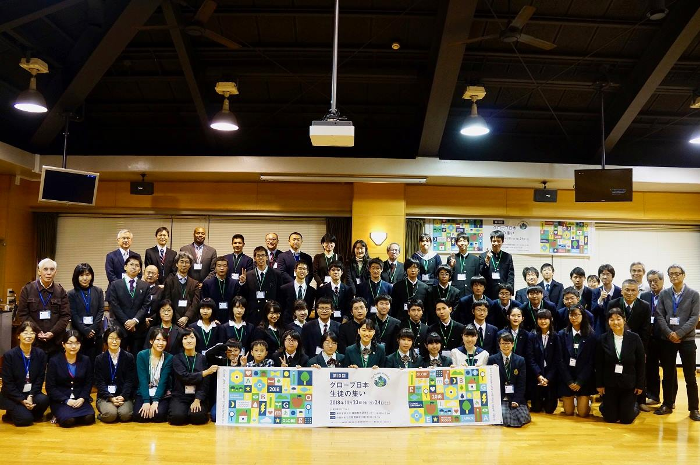
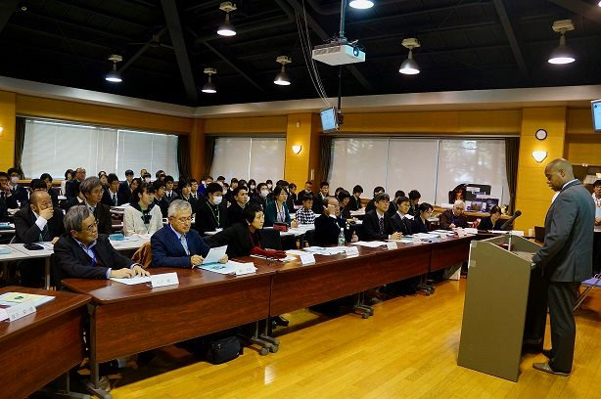

Slide 13
GLOBE Learning Expedition to Lake Pokhara
The GLOBE Regional Coordination Office for Asia and Pacific joined with the Indian Environmental Society (IES) in collaboration with Environmental Camps for Conservation Awareness (ECCA) of Kathmandu to organize a seven-day GLOBE Regional Learning Expedition in Kathmandu and Pokhara, Nepal during October 2-8, 2018
The goal of the expedition was to create a platform for culturally diverse participants to engage in a hands-on learning experience centered around understanding the effects of climate change in the region through the use of relevant GLOBE protocols..
The participants were from Thailand (8), Taiwan (15) Oman (7), India (8) and Nepal (6).

Slide 14
GLOBE Learning Expedition to Lake Pokhara
The participants participated in various Protocol such as training on Atmosphere Protocol, Hydrology Protocol & Soil Protocol & Data Entry Protocol.
They collected data of current temperature, pH, turbidity & Conductivity as well as Cloud Type and Cloud Cover along with Soil Temperature & Texture.
Participants discussed the importance of these protocols and the impact on the local environment that comes from engaging in a focused study of the atmosphere.
The programme provided an opportunity to the GLOBE schools of India, Nepal, Thailand, Taiwan & Oman was in active participation & understanding of the GLOBE Protocol.

Slide 15
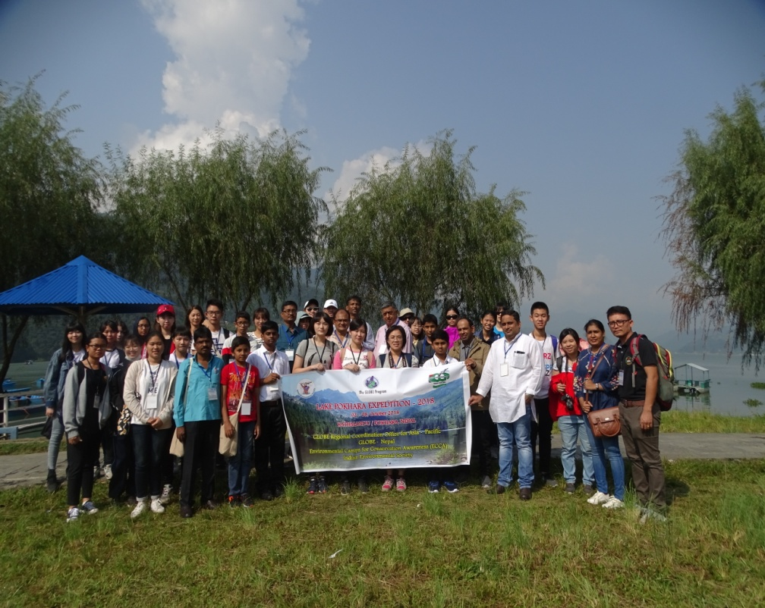
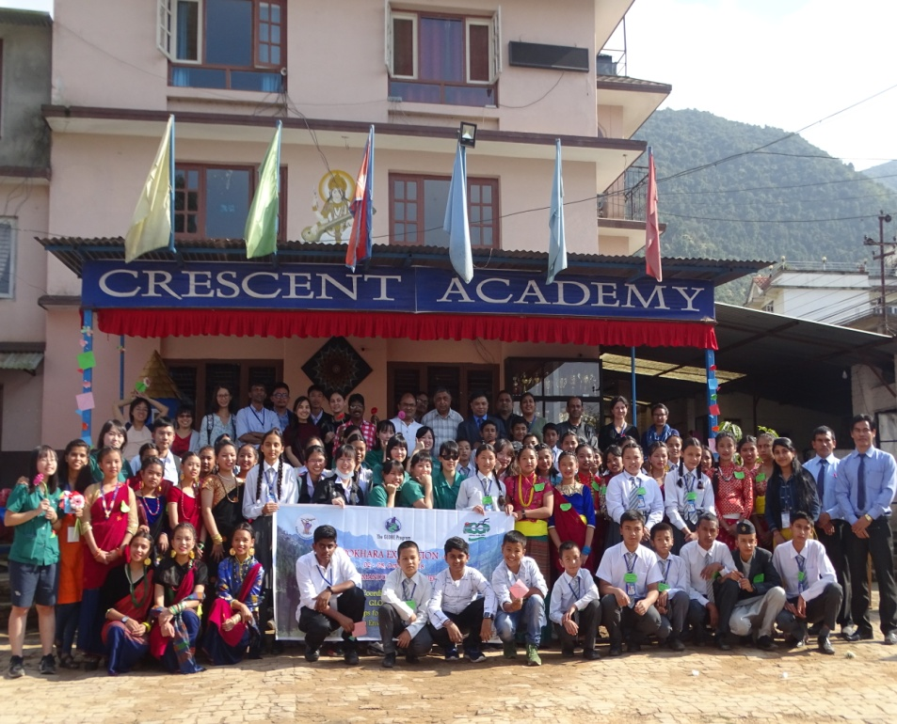

Slide 16
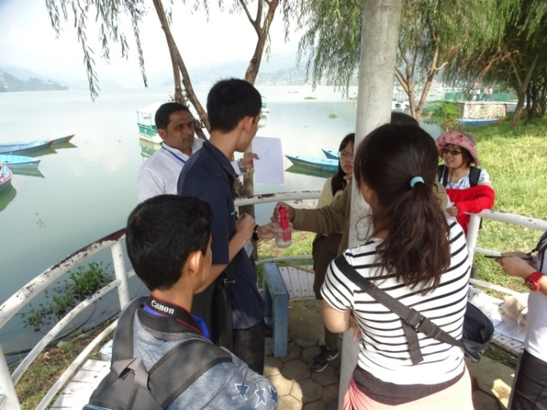
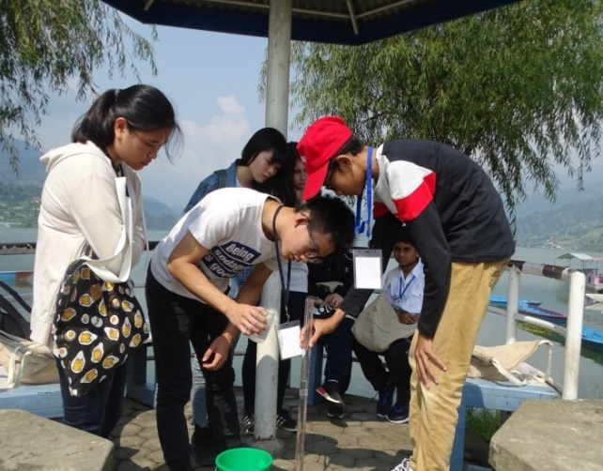
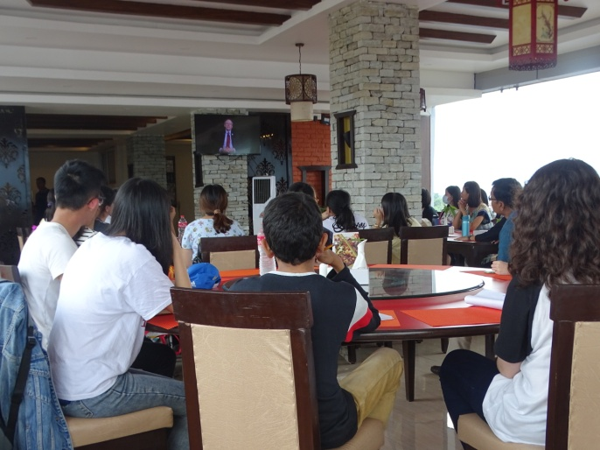
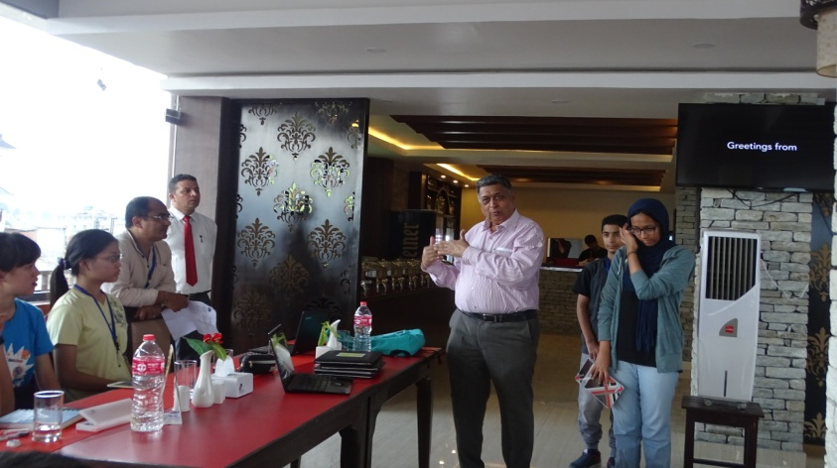

Slide 17
GLOBE Science Festival - Taiwan
The GLOBE Partner-Taiwan organized 2018 GLOBE Taiwan Science Festival for Asia Pacific Region during July 20-22, 2018 in Taichung, Taiwan.
76 teachers and students from Taiwan, Thailand and the Philippines participated in the event.
Reports (by way of posters) were presented by both students and teachers during the science festival.
Seven of which were presented by the Taiwan teams, three by Thailand & four by Philippines.
The GLOBE students’ poster presentation section was one of highlights in this exhibition
The GLOBE Taiwan Science Festival is an annual event and aims to provide opportunities for GLOBE Taiwan students to present their GLOBE science investigations results to the public.

Slide 18
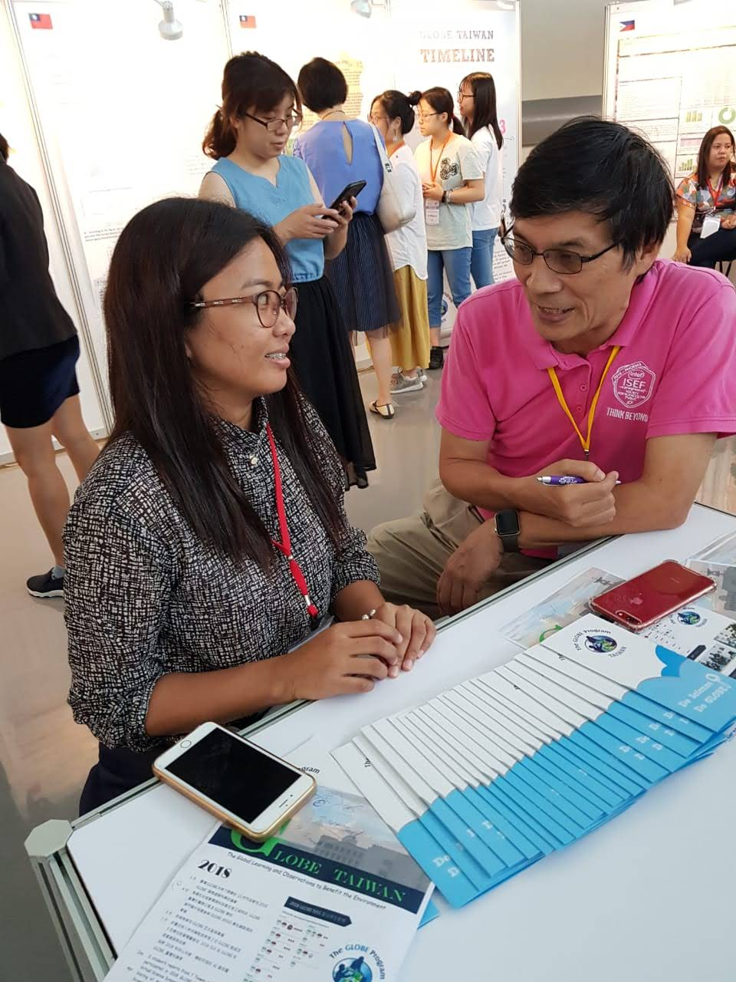
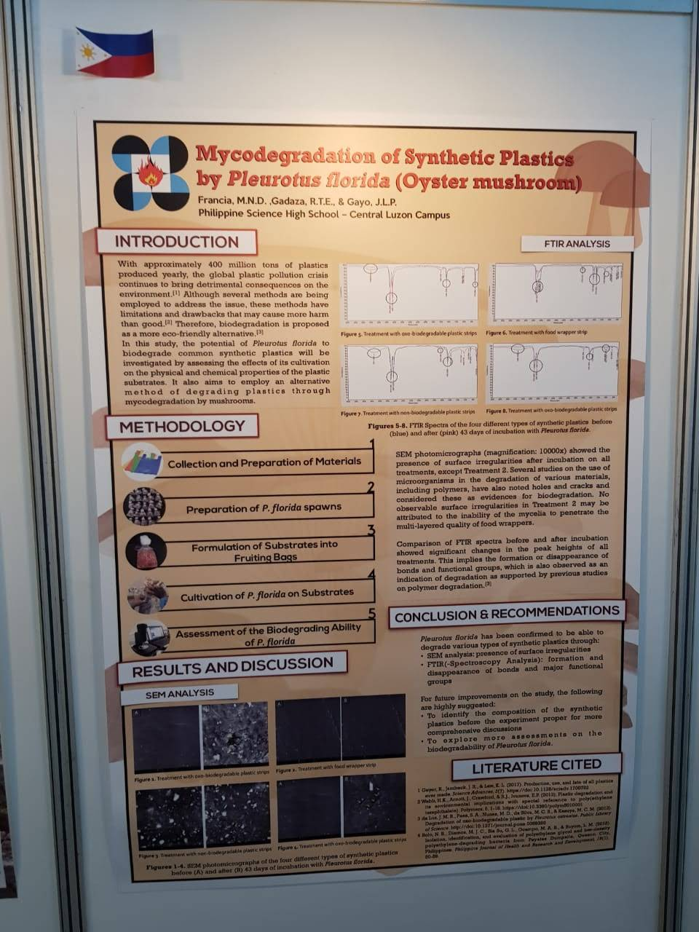
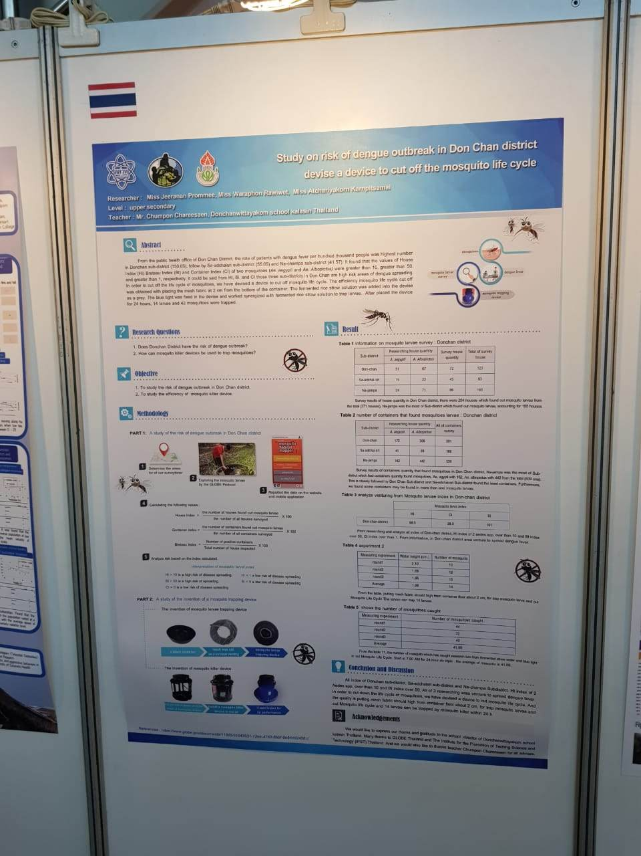

Slide 19
GLOBE Teacher's Training, Hanoi, Vietnam
GLOBE Teacher Training Workshop was conducted on May 5, 2018 in Hanoi.
The training was attended by 35 teachers from different School in Hanoi.
GLOBE Protocol such as atmosphere, hydrology & soil.
Dr. Tony P. Murphy, Dr. R.K.Garg & Dr. Desh Bandhu were the master trainer for the program.
A session on data entry was also led by Dr. David Overoy during which is explain to the participants about user interface on the website & how to use data visualization for making reports & how to use GLOBE MHM App.

Slide 20
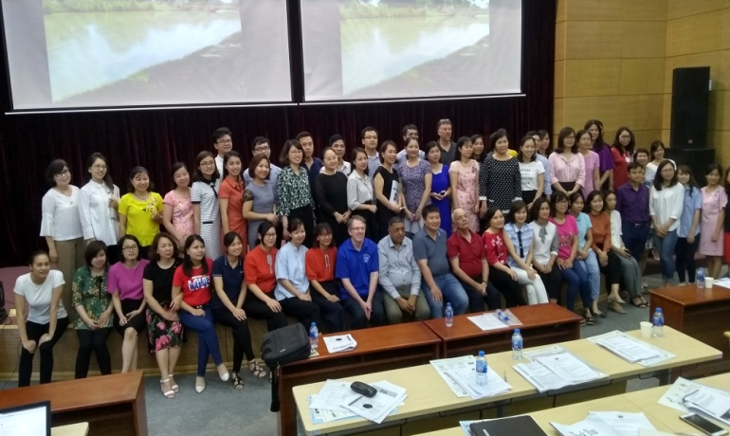
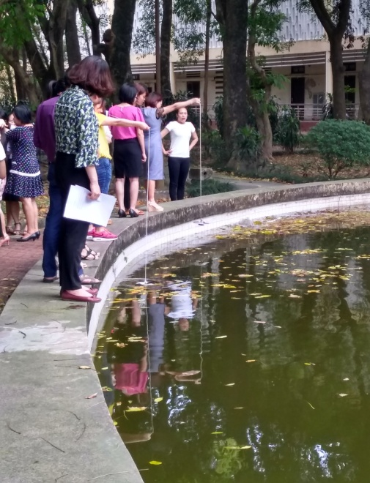
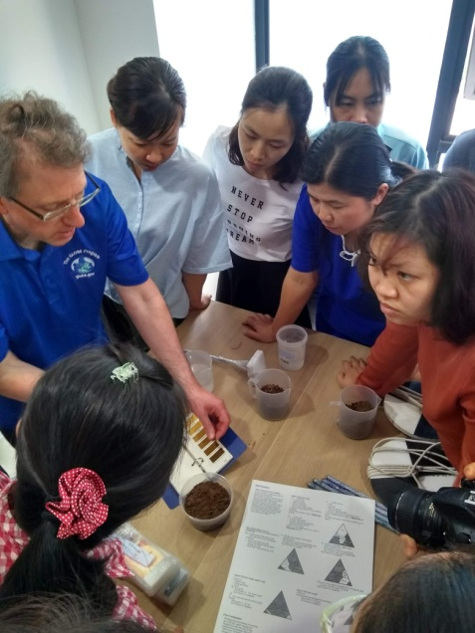
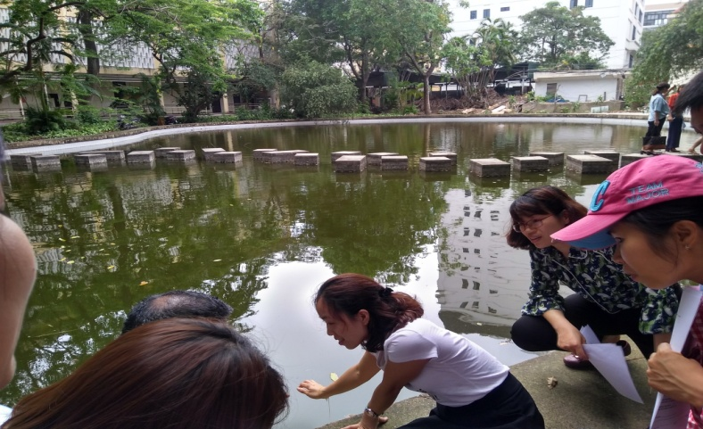

Slide 21
GLOBE Annual Regional Meeting Hanoi, Vietnam
GLOBE Annual Regional Meeting was held in Hanoi, Vietnam during May 6-9, 2018 which was organized by GLOBE Regional Coordination Office in association with GLOBE – Vietnam & GIO.
Total 30 Participants from 15 country participated in the program.
(India, Japan, Marshall Island, Micronesia, Magnolia, Maldives, Nepal, New Zealand, Palau, Philippines, Republic of Korea, Sri Lanka, Taiwan Partner, Thailand, Vietnam )
During the meeting GLOBE Strategic Plan was discussed in detail, explaining its aim and how this can be implemented in GLOBE schools in the Country.
Short term goal from the GLOBE Strategic Plan were focused to be achieved by 2020 in the region.

Slide 22
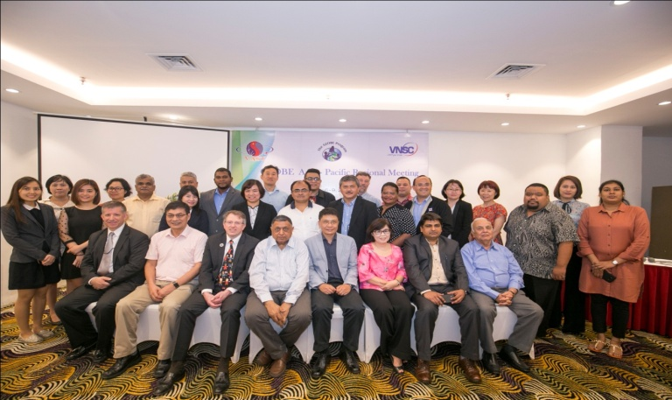
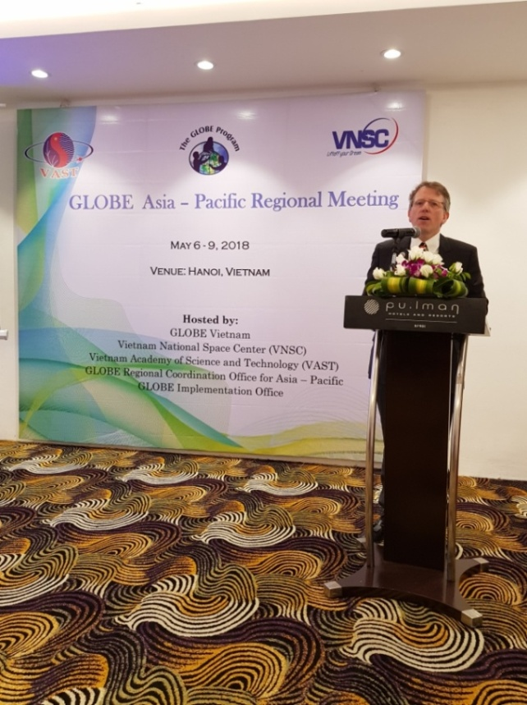
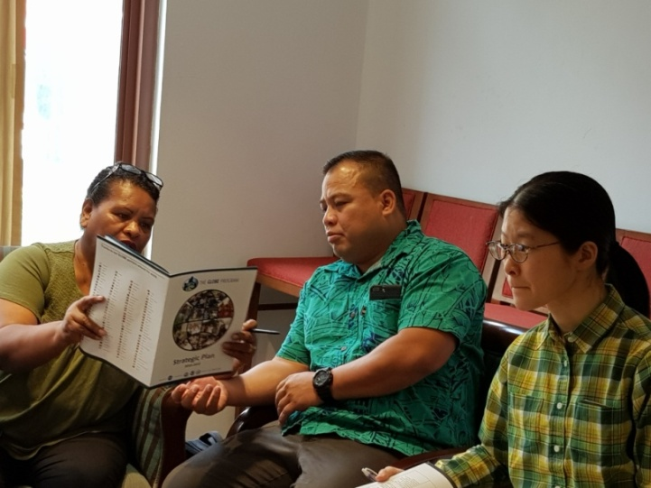

Slide 23
GLOBE Implementation Office, USA has appointed GLOBE Regional Coordination office for Asia – Pacific to implement the GLOBE ZIKA Education & Prevention Program in the region under the title “GLOBE: Engaging Citizens in the Forecasting and Observation of Mosquito Threats”.
GLOBE Regional Coordination Office for Asia – Pacific organize Regional Mosquito Training (RMT) in Hanoi, Vietnam on 10 -11 May 2018.
The project aims to enlist thousands of students, teachers, and community leaders to collect data on mosquito's for a global mapping project.

Slide 24
There are 5 initial implementation countries in A&P that are supported to do CMTs and LMWs.
Other countries are encouraged to apply for Action Grants to conduct CMTs and LMWs in their own country
Country Bold = Focus Country | RMT Participants | # of CMTs Per Country | # CMT Participants | # LMWs | # LMW Participants
Fiji | 1 | 3 | 75 | 75 | 1,875
India | 1 | 6 | 150 | 150 | 3,750
Marshall Island | 3 | 6 | 150 | 150 | 3,750
Micronesia | 3 | 6 | 150 | 150 | 3,750
Nepal | 2 | 3 | 75 | 75 | 1,875
Palau | 3 | 6 | 150 | 150 | 3,750
Philippines | 4 | 9 | 225 | 225 | 5,625
Thailand | 3 | 9 | 225 | 225 | 5,625
Vietnam | 3 | 6 | 150 | 150 | 3,750
 | 23 | 54 | 1,350 | 1,350 | 33,750

Slide 25
Country Mosquito Training – Status
The Country Mosquito Training programs focused on the control and identification of different species of mosquitoes. Mosquitoes are known to transmit serious diseases, including yellow fever, Zika fever, malaria, and dengue.
This program was very beneficial to the students and teachers as it will help them maintain a healthy school, homes & community environment and identify the particular species of mosquito.
The teacher’s attending the training program where provided with a magnifying lens fitted with focus light and zoom, to identify the mosquito larvae prevalent in their respective school areas present in the community, click a picture of the same and upload the data directly on GLOBE MHM App.

Slide 26
Country Mosquito Training – Status
GLOBE –India organized 4 CMTs during August, 2018 & in May, 2019 during which they have trained 85 T2 Trainers. GLOBE – India organized CMTs in New Delhi, Gujarat, Bhopal & Haryana.
GLOBE –Marshall Island organized 3 CMTs during August, September & December 2018 during which they have trained 73 T2 Trainers. These CMT were organized in CMTs in Majuro & Wotje Atoll.
GLOBE –Micronesia organized 3 CMTs during August & November 2018 during which they have trained 48 T2 Trainers. These CMTs were organized in Pohnpei & Kolonia.
GLOBE –Nepal organized 3 CMTs during July to September, 2018 during which they have trained 79 T2 Trainers. GLOBE – Nepal organized CMTs in Kathmandu, Jhapa & Lalitpur.

Slide 27
Country Mosquito Training – Status
GLOBE –Palau organized 2 CMTs during July 2018 & January, 2019 during which they have trained 25 T2 Trainers. GLOBE – Palau organized CMTs in Koror.
GLOBE –Philippines organized 3 CMTs during September & October, 2018 during which they have trained 458 T2 Trainers. GLOBE – Philippines organized CMTs in Quezon City, Palawan City & Bicol in Philippines.
GLOBE –Sri Lanka organized 1 CMT during July, 2018 during which they have trained 24 TS Trainers. GLOBE – Sri Lanka has organized the CMT at Maharagama.
GLOBE –Thailand has organized 4 CMTs from the month of June to September, 2018 during which they have trained 226 T2 Trainers. These CMTs were organized in various part of Thailand Such as Bangkok, Khonkean, Songkhla & Chonburi.
GLOBE –Vietnam organized 6 CMTs during June to September, 2018 during which they have trained 196 T2 Trainers. These CMTs were organized in Hanoi, Long Xuyên, Hồ Chí Minh & Nha Trang.

Slide 28
Local Mosquito Workshop – Status
After CMT training T2 trainers are eligible to apply for Action Grants to conduct Local Mosquito Workshops (LMWs)
GLOBE – Thailand has conducted 17 LMWs and has trained 2568 LMW Participants but they have only updated 203 LMW participants in GLOBE workshop tool.
GLOBE – Philippines has conducted 4 LMWs and has trained 150* LMW Participants but they still have updated the participants in GLOBE workshop tool.(*status of pre & post Survey)
GLOBE – India has conducted 1 LMW and has trained 250 Participants.

Slide 29
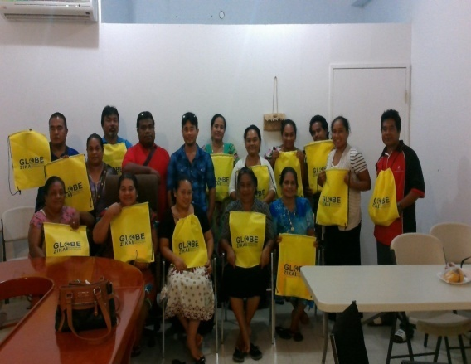
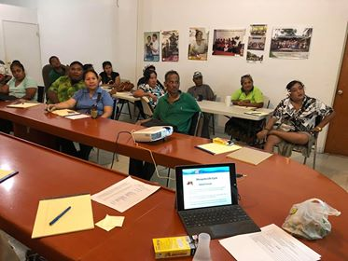
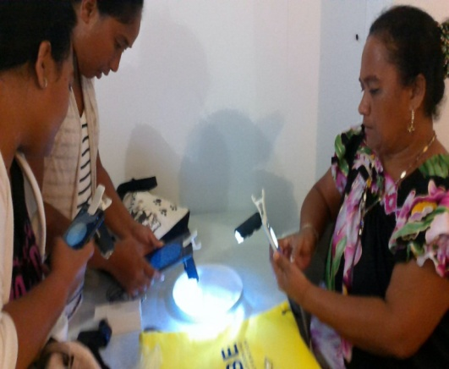
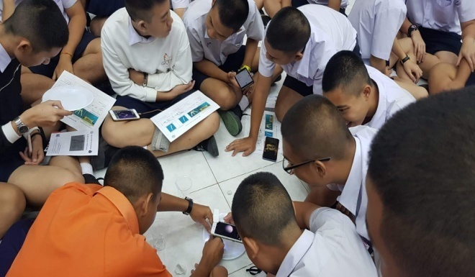
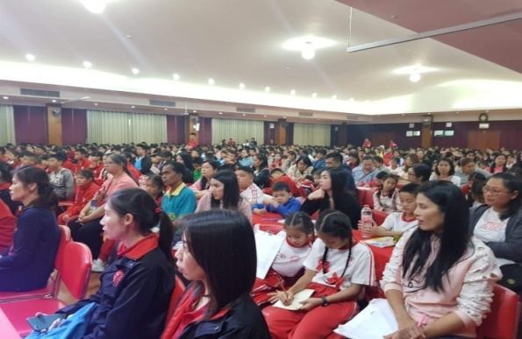
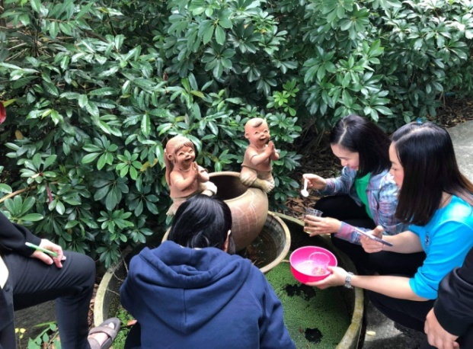
Micronesia
Thailand

Slide 30
GLOBE ZIKA Education & Prevention Program – Status
Country Bold = Focus Country | RMT Participants | # of CMTs Per Country | # CMT Participants | # CMT Participants register in workshop Tool | Remaining Participants to Train | # LMWs | # LMW Participants | # accutal LMW Participants
Fiji | 1 | 3 | 75 | 0 | 75 | 75 | 1875
India | 1 | 6 | 150 | 93 | 57 | 150 | 3750 | 250
Marshall Island | 3 | 6 | 150 | 51 | 99 | 150 | 3750
Micronesia | 3 | 6 | 150 | 48 | 102 | 150 | 3750
Maldives | 1 | 2 | 50 | 0 | 50 | 50 | 1250
Nepal | 2 | 3 | 75 | 79 | + 4 | 75 | 1875
Palau | 3 | 6 | 150 | 12 | 138 | 150 | 3750
Philippines | 4 | 9 | 225 | 386 | + 161 | 225 | 5625 | 100
Thailand | 3 | 9 | 225 | 226 | +1 | 225 | 5625 | 230
Vietnam | 3 | 6 | 150 | 196 | + 46 | 150 | 3750
 | 23 | 54 | 1400 | 1020 | 796 | 1400 | 35000

Slide 31
Future Plan for Implanting THE GLOBE Program in the Region during 2019 – 2020
To promote citizen Science Congress through networking of GLOBE School in the Region.
To organize different Exchange Program / expedition within the region Like in the past with Lake pokhara Expedition etc.
Promoting eco-restoration activities among the youths and community people by developing “Young Friends of Environment - YOEF” Program in GLOBE School in the region.
Capacity Building Workshops – 6 Nos.
Data Collection & Data Submission by GLOBE Observer App Workshop for Schools.

Slide 32
Thank you

